Slide 1



Slide 2


Team Member
Hadeel Aldhafiri
Alanoud Alrashed
Rawan

Slide 3
Introduction
Netflix is a stream platform that offer TV shows and Movies.
The objectives:
Visualize different information about Netflix:
How Netflix started and progress over the years.
What is the top countries using the platform.
To show the Percentage of movies and tv shows in the platform.
The ratio between different rows and columns.

Slide 4
Dataset
The data collected from Kaggel website.
The dataset contains 10 columns and 8790 records.
The columns as the following:
show_id, type, title, director, country, date_added, release_year, rating, duration, and listed_in.

Slide 5
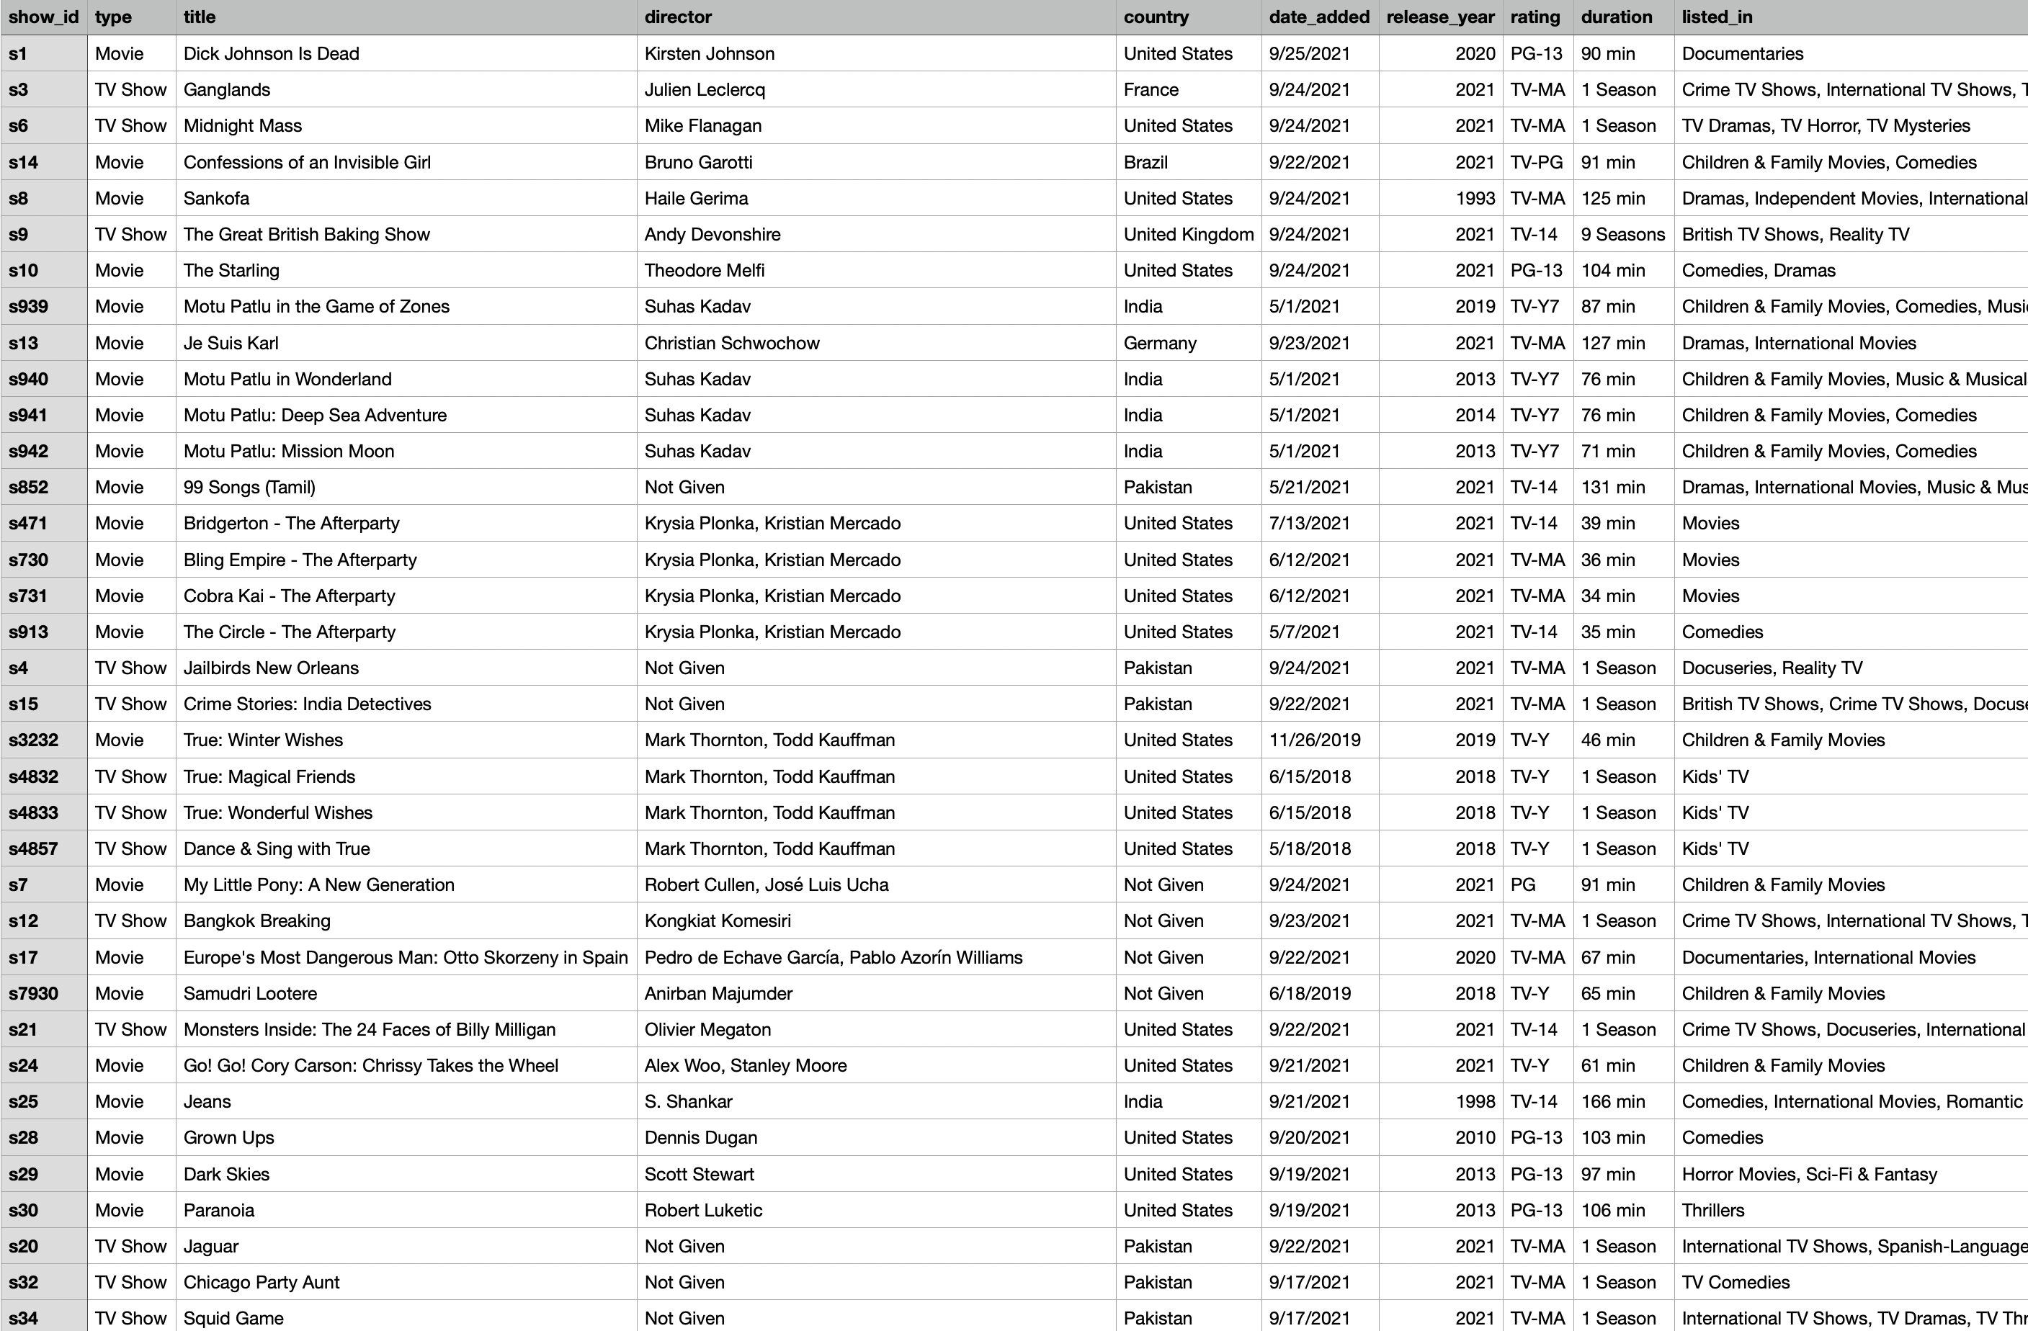

Slide 6
Thank you for your time…

